Slide 1


SAIM SAFDAR Cloud Native Developer Istio: Canaries and Kubernetes
Recording: https://www.youtube.com/watch?v=YQLOcjvbo9s
@imsaimsafder14
saimsafder14@gmail.com
Link
bit.ly/istio-canaries
bit.ly/istio-tutorial

Slide 2
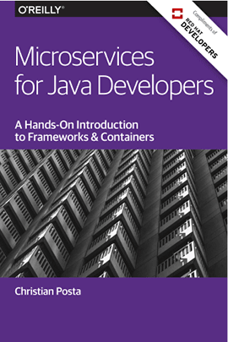
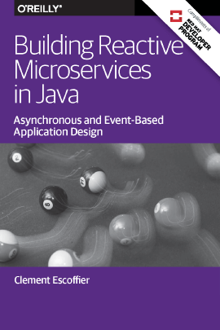
bit.ly/javamicroservicesbook
bit.ly/reactivemicroservicesbook
Free eBooks from developers.redhat.com
Microservices Introductory Materials
Demo: bit.ly/msa-instructions
Slides: bit.ly/microservicesdeepdive
Video Training: bit.ly/microservicesvideo
Kubernetes for Java Developers
Microservices Advanced Materials
bit.ly/istio-tutorial
bit.ly/mono2microdb
http://bit.ly/istio-canaries
Istio.io
@burrsutter

Slide 3
Monolith
MyApp
@burrsutter

Slide 4
Microservices
@burrsutter

Slide 5
Microservices
@burrsutter

Slide 6
Microservices
@burrsutter

Slide 7
Microservices
@burrsutter

Slide 8
Microservices
@burrsutter

Slide 9
Microservices
@burrsutter

Slide 10
Network of Services
@burrsutter

Slide 11
Microservices == Distributed Computing
OS
OS
JVM
JVM
Service A
Service C
OS
JVM
Service B
@burrsutter

Slide 12





Microservices'ilities
API
Tracing
Discovery
Monitoring
Invocation
MyService
Logging
Elasticity
Authentication
Resilience
Pipeline
@burrsutter

Slide 13


Short History of Microservices
AWS EC2
2006
Java EE6
2009
DropWizard
May 2011
Hystrix
March 2012
Eureka
July 2012
Spring Boot
Sept 2013
Kubernetes
June 2014
Continuous
Integration
via XP
1999
DevOps
2009
Agile
Manifesto
Feb
2001
NETFLIX
to AWS
2010
Ribbon
March 2012
Microservices
Assess
Thoughtworks
Radar
March 2012
Docker
March
2013
Microservices
Defined
Thoughtworks
Fowler, Lewis
March 2014
@burrsutter
Notes:
http://redmonk.com/sogrady/2014/03/27/micro-services/
https://www.slideshare.net/adriancockcroft/speeding-up-31799721
https://en.wikipedia.org/wiki/Java_EE_version_history#Java_EE_6_.28December_10.2C_2009.29
https://assets.thoughtworks.com/assets/technology-radar-march-2012.pdf
Netflix and Kubernetes https://www.youtube.com/watch?v=57UK46qfBLY&feature=youtu.be&t=37m21s
https://thenewstack.io/github-goes-kubernetes-tells/
Docker born March 2013
https://www.youtube.com/watch?v=9xciauwbsuo

Slide 14
What's Wrong with Netflix OSS?
Java Only
Adds a lot of libraries to YOUR code

Slide 15
Microservices embedding Capabilities
Container
Container
JVM
JVM
Service A
Service C
Discovery
Discovery
Load-balancer
Load-balancer
Resiliency
Resiliency
Metrics
Metrics
Tracing
Tracing
Container
JVM
Service B
Discovery
Load-balancer
Resiliency
Metrics
Tracing
@burrsutter

Slide 16
Microservices'ilities
API
Tracing
Discovery
Monitoring
Invocation
MyService
Logging
Elasticity
Authentication
Resilience
Pipeline
@burrsutter

Slide 17
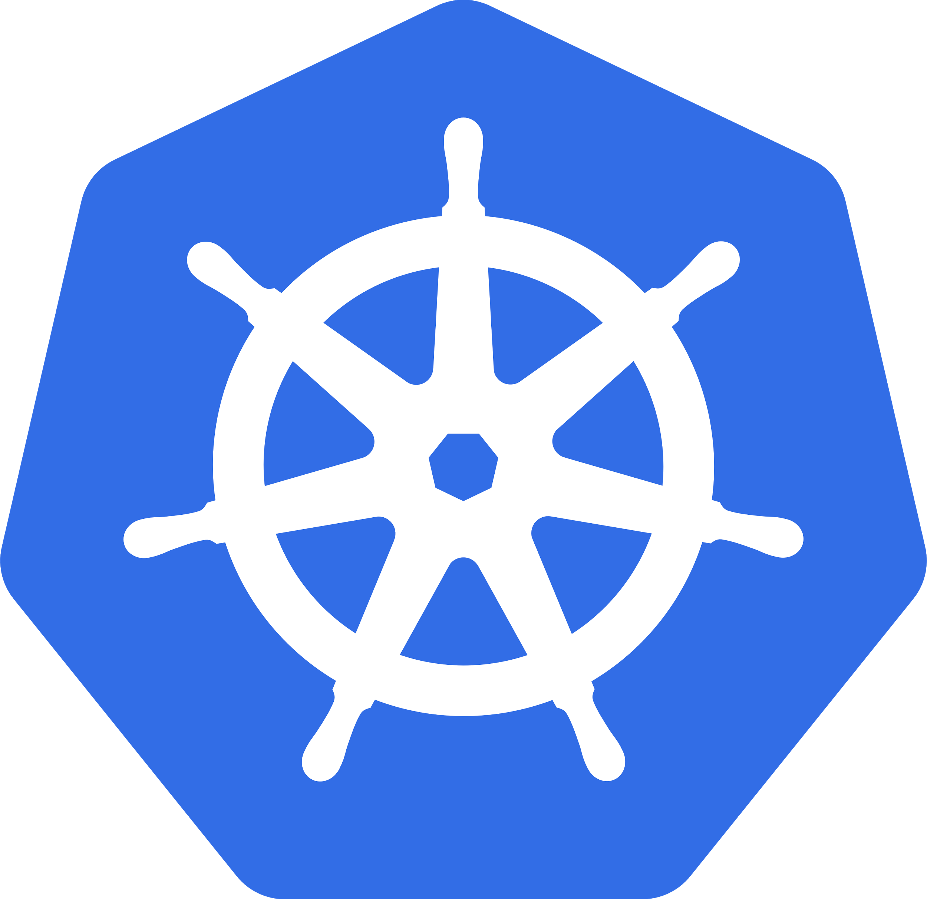

@burrsutter

Slide 18
Microservices'ilities + Kubernetes
API
Tracing
Discovery
Monitoring
Invocation
MyService
Logging
Elasticity
Authentication
Resilience
Pipeline
@burrsutter

Slide 19
Microservices'ilities + OpenShift
API
Tracing
Discovery
Monitoring
Invocation
MyService
Logging
Elasticity
Authentication
Resilience
Pipeline
@burrsutter

Slide 20

Istio - Sail
(Kubernetes - Helmsman or ship’s pilot)
@burrsutter

Slide 21
Service Mesh Defined
A service mesh is a dedicated infrastructure layer for handling service-to-service communication. It’s responsible for the reliable delivery of requests through the complex topology of services that comprise a modern, cloud native application. In practice, the service mesh is typically implemented as an array of lightweight network proxies that are deployed alongside application code, without the application needing to be aware
https://buoyant.io/2017/04/25/whats-a-service-mesh-and-why-do-i-need-one/

Slide 22

Microservices'ilities + Istio
API
Tracing
Discovery
Monitoring
Invocation
MyService
Logging
Elasticity
Authentication
Resilience
Pipeline
@burrsutter

Slide 23
Microservices embedding Capabilities
Container
Container
JVM
JVM
Service A
Before Istio
Service C
Discovery
Discovery
Load-balancer
Load-balancer
Resiliency
Resiliency
Metrics
Metrics
Tracing
Tracing
Container
JVM
Service B
Discovery
Load-balancer
Resiliency
Metrics
Tracing
@burrsutter

Slide 24
Microservices externalizing Capabilities
Pod
Pod
Container
Container
JVM
JVM
Service A
After Istio
Service C
Sidecar Container
Sidecar Container
Pod
Container
JVM
Service B
Sidecar Container
@burrsutter

Slide 25

Kubernetes, Istio, Envoy
Pod
Pod
Container
Container
JVM
JVM
Service A
Service C
Sidecar Container
Sidecar Container
Pod
Container
JVM
Service B
Sidecar Container
@burrsutter

Slide 26
Next Generation Microservices - Service Mesh
Code Independent (Polyglot)
Intelligent Routing and Load-Balancing
A/B Tests
Smarter Canary Releases
Chaos: Fault Injection
Resilience: Circuit Breakers
Observability: Metrics and Tracing
Fleet wide policy enforcement
@burrsutter

Slide 27
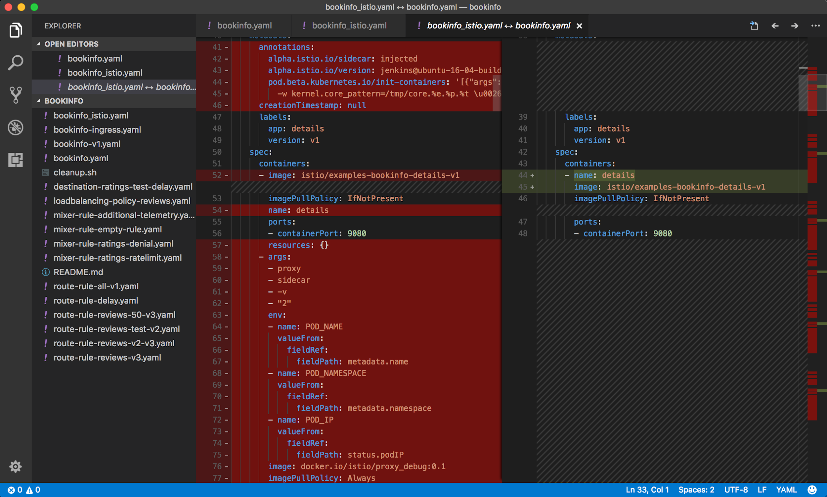

Slide 28
Istio Control Plane
Pod
Pod
Pod
Container
Container
Container
JVM
JVM
JVM
HTTP1.1, HTTP2, gRPC, TCP w/TLS
Service A
HTTP1.1, HTTP2, gRPC, TCP w/TLS
Service B
HTTP1.1, HTTP2, gRPC, TCP w/TLS
Service C
Envoy Side-car
Envoy Side-car
Envoy Side-car
Istio Pilot
Istio Mixer
Istio Auth
istioctl, API, config
Quota, Telemetry Rate Limiting, ACL
CA, SPIFFE
@burrsutter

Slide 29

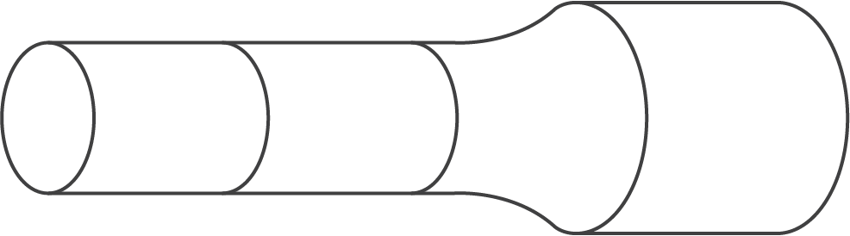



Canary Deployment
SCM
DEVELOPMENT
QA
STAGING
PRODUCTION
ROUTER
USERS
@burrsutter

Slide 30
Canary Deployment
SCM
DEVELOPMENT
QA
STAGING
PRODUCTION
ROUTER
USERS
@burrsutter

Slide 31
Canary Deployment
SCM
DEVELOPMENT
QA
STAGING
PRODUCTION
ROUTER
USERS
@burrsutter

Slide 32
Canary Deployment
SCM
DEVELOPMENT
QA
STAGING
PRODUCTION
ROUTER
USERS
@burrsutter

Slide 33
Canary Deployment
SCM
DEVELOPMENT
QA
STAGING
PRODUCTION
ROUTER
USERS
@burrsutter

Slide 34
Canary Deployment
SCM
DEVELOPMENT
QA
STAGING
PRODUCTION
ROUTER
USERS
@burrsutter

Slide 35
Canary Deployment
SCM
DEVELOPMENT
QA
STAGING
PRODUCTION
ROUTER
USERS
@burrsutter

Slide 36
Canary Deployment
SCM
DEVELOPMENT
QA
STAGING
PRODUCTION
ROUTER
USERS
@burrsutter

Slide 37
Canary Deployment
SCM
DEVELOPMENT
QA
STAGING
PRODUCTION
ROUTER
USERS
@burrsutter

Slide 38
Canary Deployment
SCM
DEVELOPMENT
QA
STAGING
PRODUCTION
ROUTER
USERS
@burrsutter

Slide 39

Canaries with Kubernetes
Pod
Container
JVM
50%
Service A v1
Route/
Ingress
Service
Pod
Container
JVM
Service A v2
50%
@burrsutter

Slide 40
Canaries with Istio
Pod
Container
JVM
90%
Service A v1
Route/
Ingress
Service
Pod
Container
JVM
Service A v2
10%
@burrsutter

Slide 41
Demo
bit.ly/istio-tutorial
@burrsutter

Slide 42
bit.ly/javamicroservicesbook
bit.ly/reactivemicroservicesbook
Free eBooks from developers.redhat.com
Microservices Introductory materials
Demo: bit.ly/msa-instructions
Slides: bit.ly/microservicesdeepdive
Video Training: bit.ly/microservicesvideo
Microservices Advanced Materials
bit.ly/istio-tutorial
bit.ly/mono2microdb
http://bit.ly/istio-canaries
Istio.io
@burrsutter

